Slide 1
Keeping the main thing the main thing.

Slide 2
John 17:18
"As you sent me into the world, so I have sent them into the world."

Slide 3
Matthew 28:18-20
And Jesus came and said to them, “All authority in heaven and on earth has been given to me. Go therefore and make disciples of all nations, baptizing them in the name of the Father and of the Son and of the Holy Spirit, teaching them to observe all that I have commanded you. And behold, I am with you always, to the end of the age.”

Slide 4
Matthew 22:36-40
“Teacher, which is the great commandment in the Law?” And he said to him, “You shall love the Lord your God with all your heart and with all your soul and with all your mind. This is the great and first commandment. And a second is like it: You shall love your neighbor as yourself. On these two commandments depend all the Law and the Prophets.”

Slide 5
1 Corinthians 15:3 For what I received I passed on to you as of first importance: that Christ died for our sins according to the Scriptures,
Galatians 6:14 May I never boast except in the cross of our Lord Jesus Christ, through which the world has been crucified to me, and I to the world.
1 Corinthians 2:2 For I resolved to know nothing while I was with you except Jesus Christ and him crucified.
Revelation 5:12 In a loud voice they were saying: “Worthy is the Lamb, who was slain, to receive power and wealth and wisdom and strength and honor and glory and praise!”

Slide 6
Revelations 1:2
"who testifies to everything he saw—that is, the word of God and the testimony of Jesus Christ."

Slide 7
John 20:21
Jesus said to them again, “Peace be with you. As the Father has sent me, even so I am sending you.”

Slide 8
Acts 20:24 (NIV)
However, I consider my life worth nothing to me; my only aim is to finish the race and complete the task the Lord Jesus has given me—the task of testifying to the good news of God’s grace.

Slide 9
My mission in this life is to share the Good News with other people.
HOW do I fulfill my God given mission?

Slide 10
Acts 1:8
"But you will receive power when the Holy Spirit has come upon you, and you will be my witnesses in Jerusalem and in all Judea and Samaria, and to the end of the earth."

Slide 11
HOW do I fulfill my God given mission?
You start at home (your Jerusalem)

Slide 12
2 Peter 3:9
The Lord is not slow to fulfill his promise as some count slowness, but is patient toward you, not wishing that any should perish, but that all should reach repentance.

Slide 13
HOW do I fulfill my God given mission?
You start at home (your Jerusalem)
I must reach beyond my world (Judea and Samaria)

Slide 14
1 Corinthians 9:22b
I have become all things to all people, that by all means I might save some.

Slide 15
Matthew 25:34-40
Then the King will say to those on his right, ‘Come, you who are blessed by my Father, inherit the kingdom prepared for you from the foundation of the world. For I was hungry and you gave me food, I was thirsty and you gave me drink, I was a stranger and you welcomed me, I was naked and you clothed me, I was sick and you visited me, I was in prison and you came to me.’

Slide 16
Matthew 25:34-40 (continued)
Then the righteous will answer him, saying, ‘Lord, when did we see you hungry and feed you, or thirsty and give you drink? And when did we see you a stranger and welcome you, or naked and clothe you? And when did we see you sick or in prison and visit you?’ And the King will answer them, ‘Truly, I say to you, as you did it to one of the least of these my brothers, you did it to me.’

Slide 17
HOW do I fulfill my God given mission?
You start at home (your Jerusalem)
I must reach beyond my world (Judea and Samaria)
I strive to make an impact to the whole world (the ends of the earth)

Slide 18
Mark 16:15
And he said to them, “Go into all the world and proclaim the gospel to the whole creation.”

Slide 19
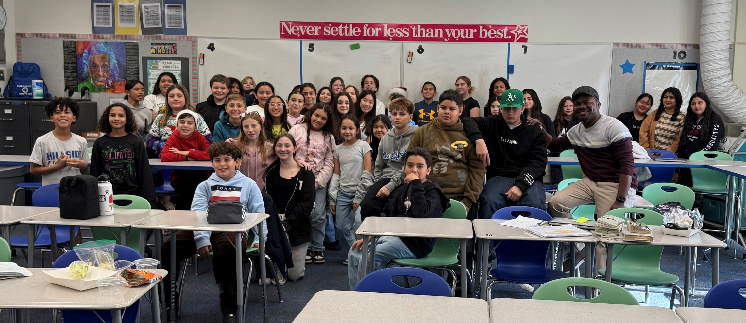
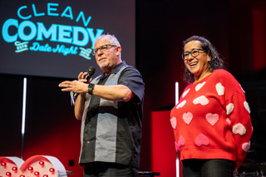
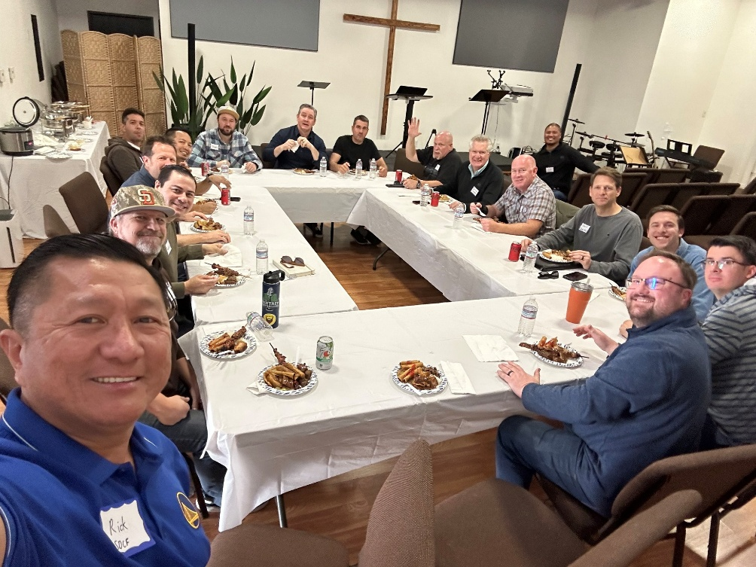
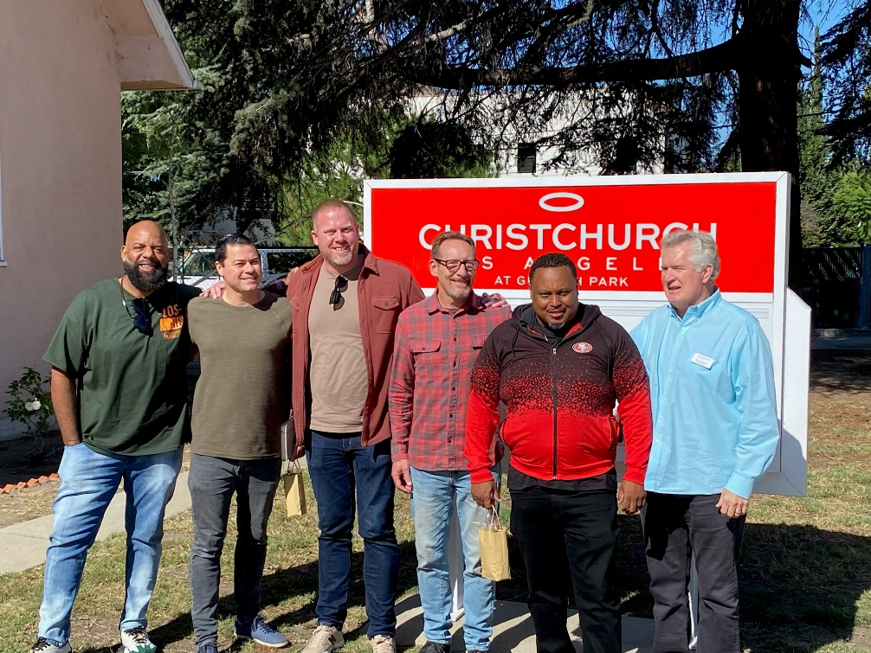
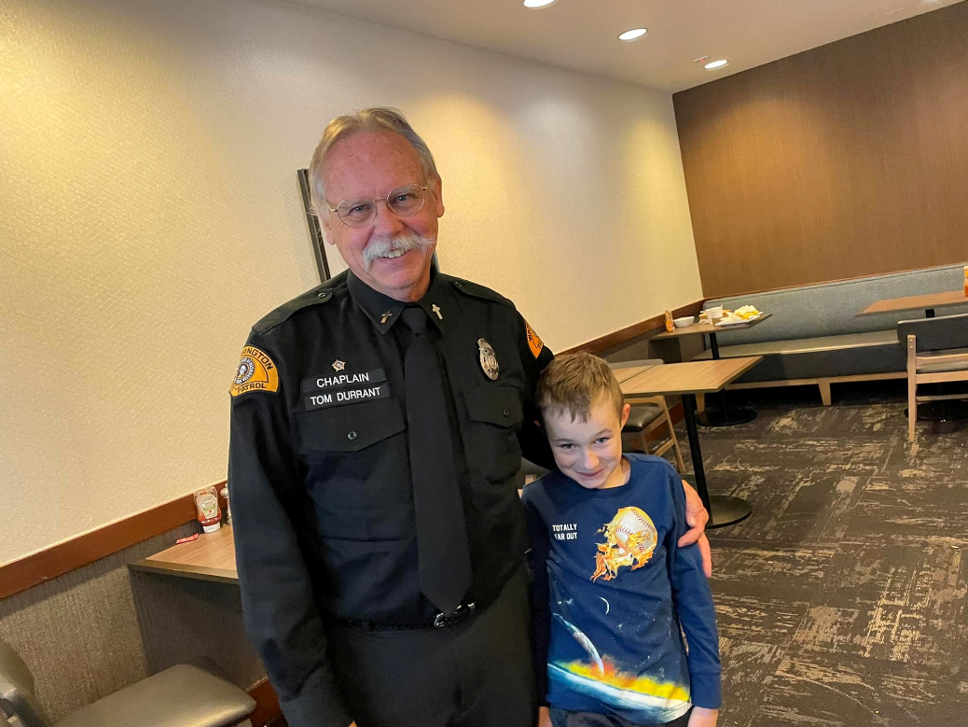
Missions CamCC supports – (Local – Jerusalem)

Slide 20
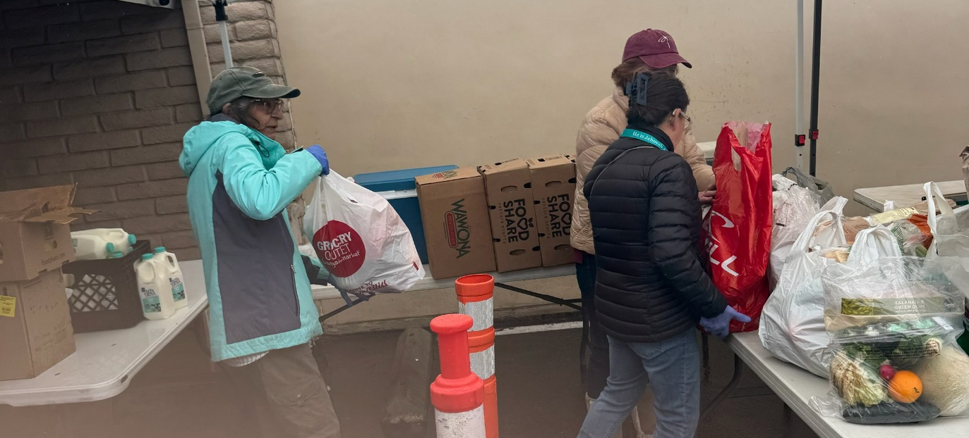
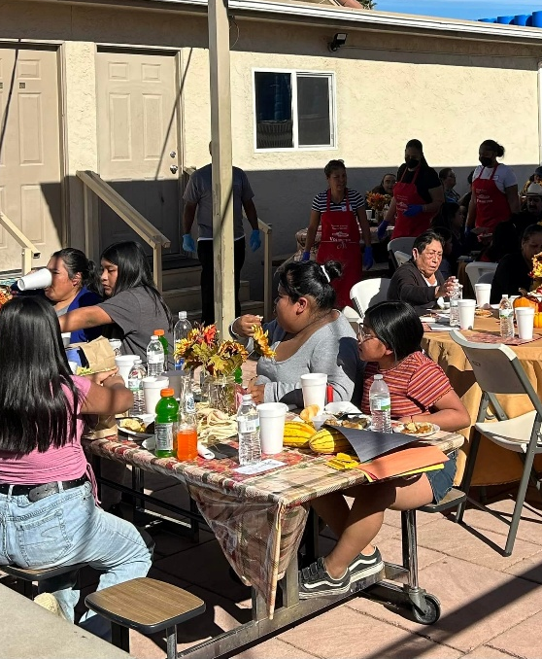
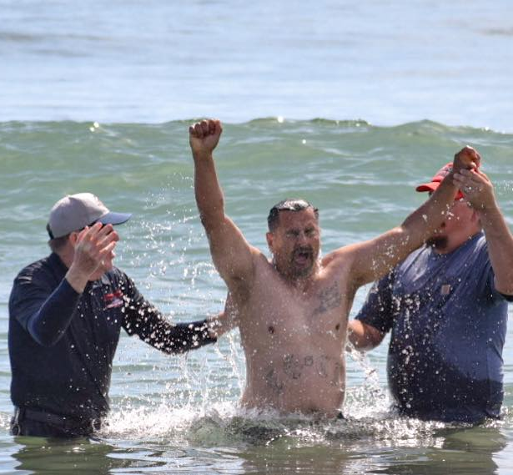
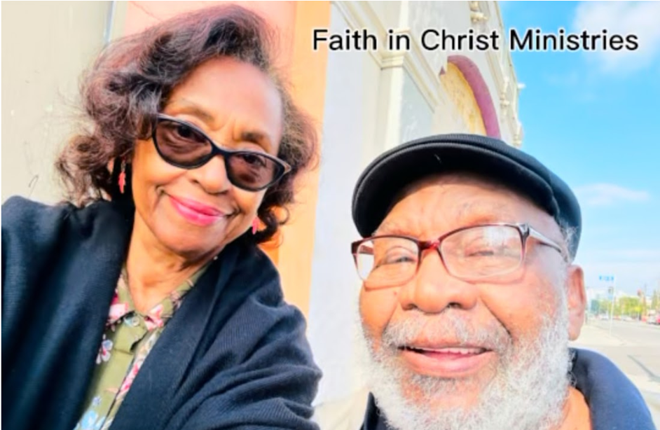
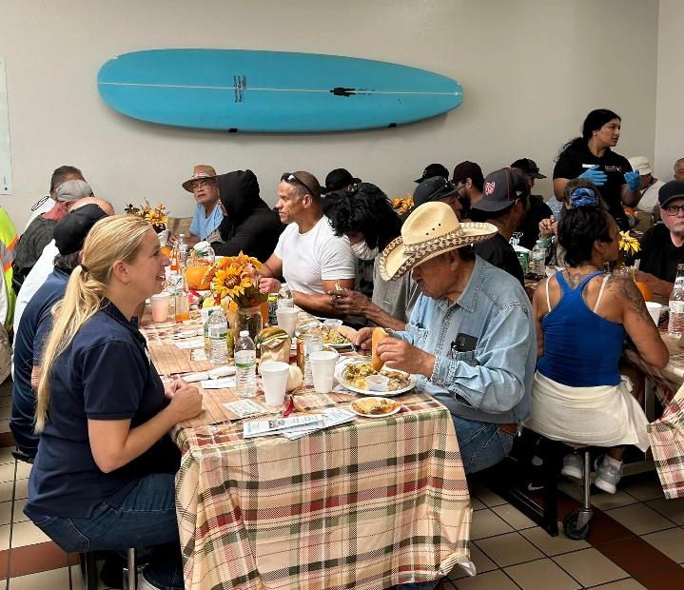
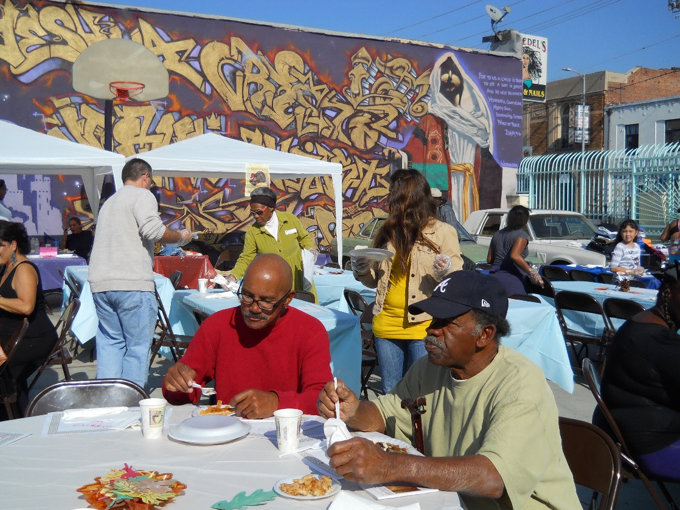
Missions CamCC supports – (Close but different - Samaria)

Slide 21
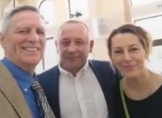
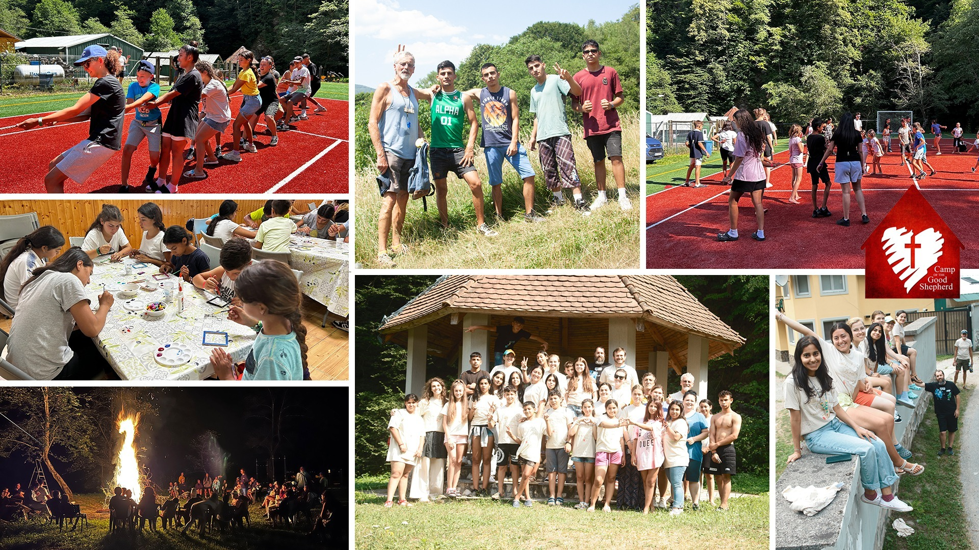
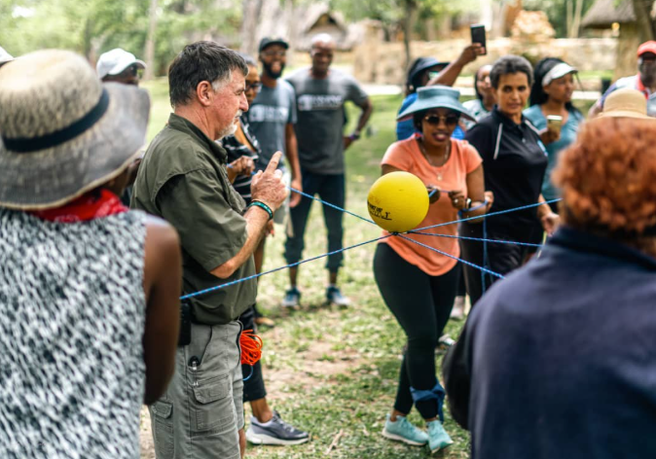
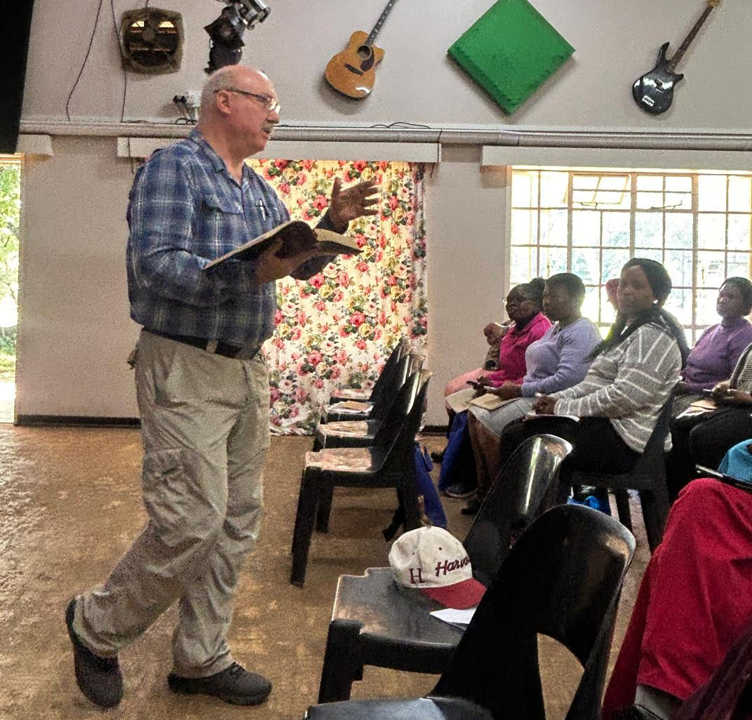
Missions CamCC supports – (The World- Ends of the Earth)

Slide 22
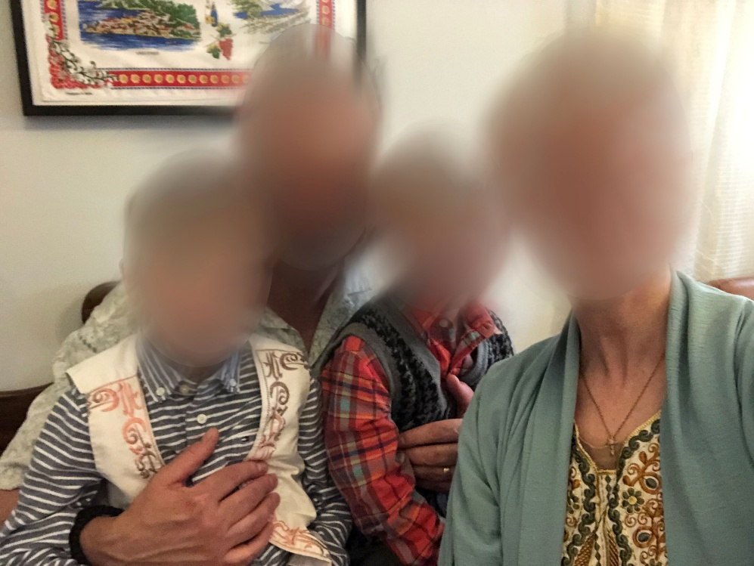
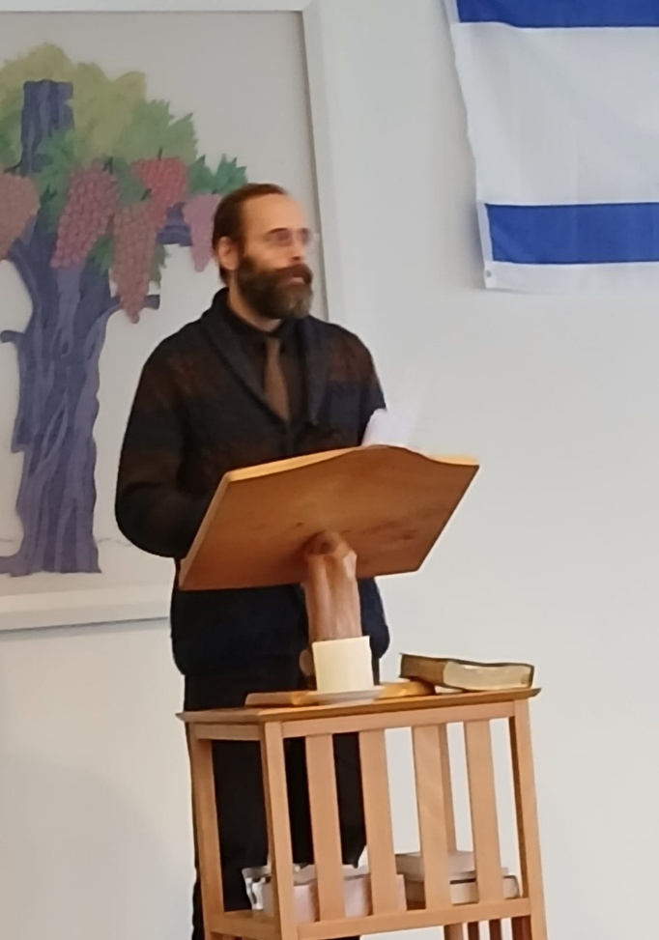
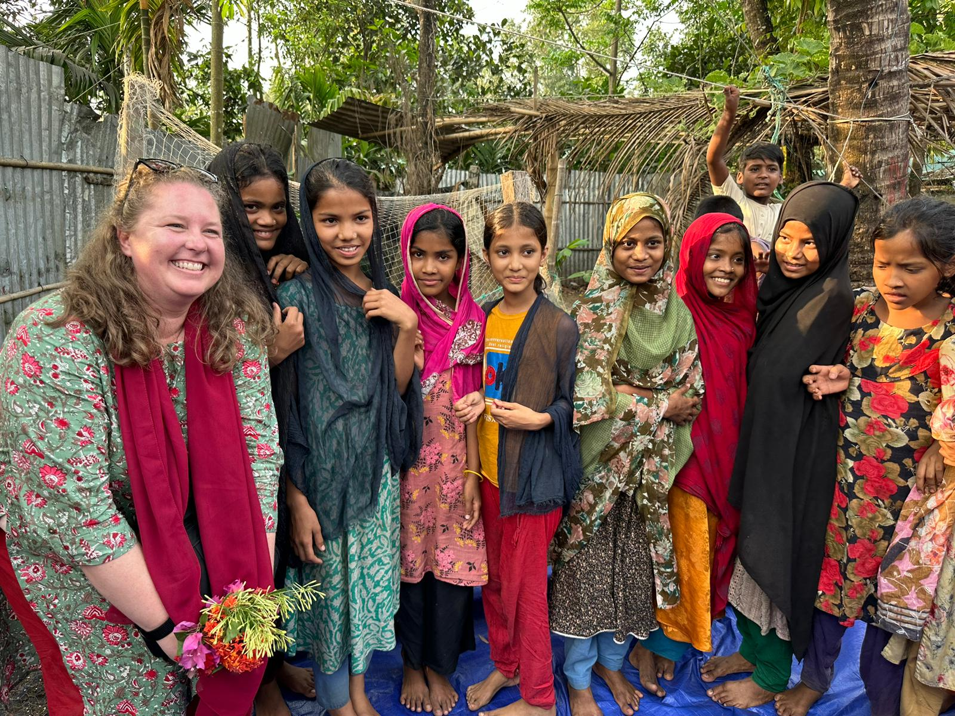
Missions CamCC supports – (The World- Ends of the Earth)
Vanya & Joyce Algra

Slide 23
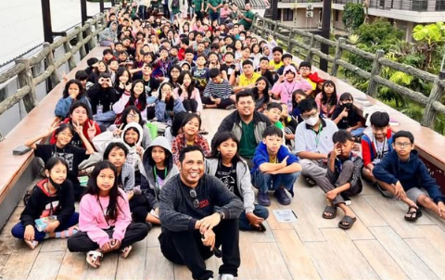
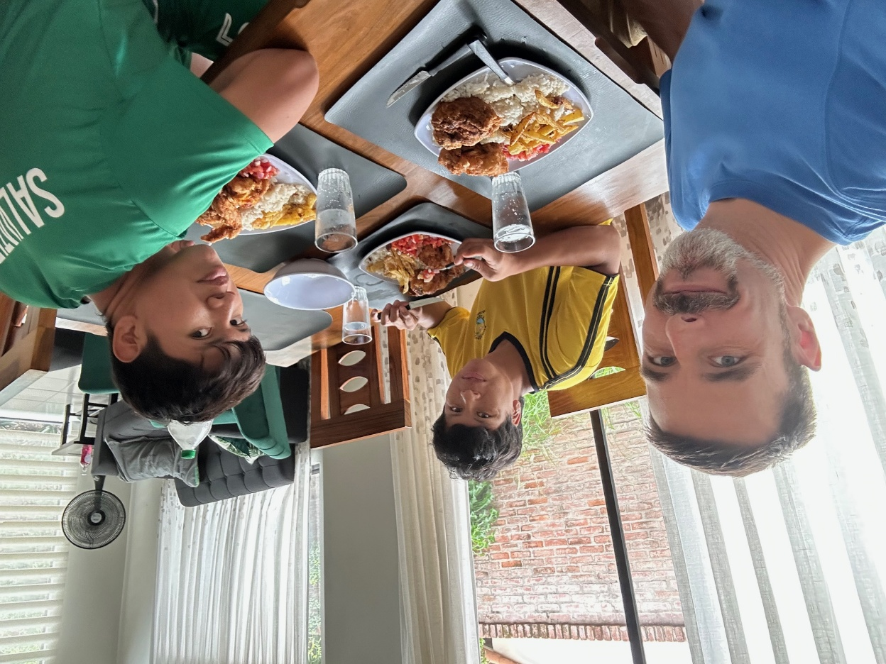
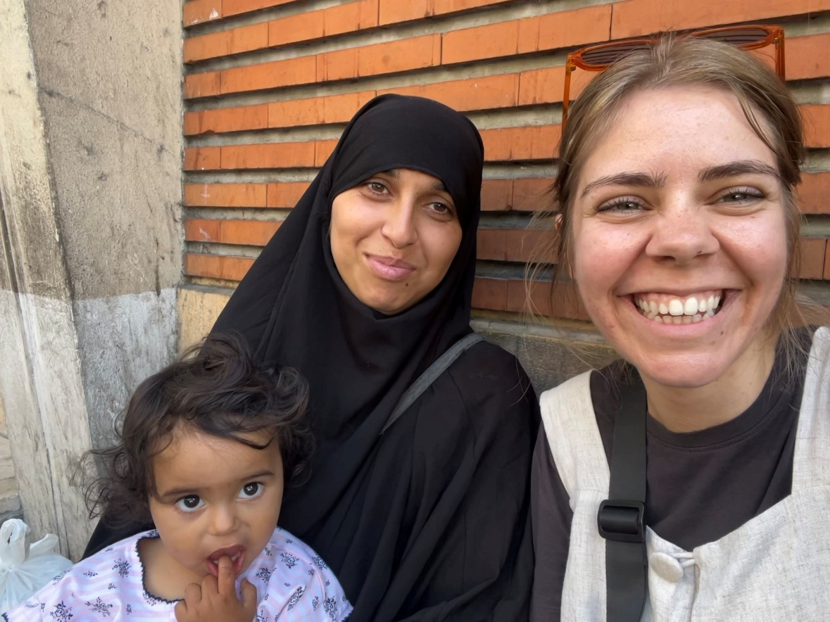
Missions CamCC supports – (The World- Ends of the Earth)

Slide 24
Big Idea
A person that is all about Jesus is someone that is committed to allowing God to use them to fulfill His mission in this World.

